Slide 1

Taming the Cluster: A Researcher’s Guide to Slurm
Notes:
Welcome, everyone! This is Taming the Cluster: A Researcher’s Guide to Slurm. My name is [Your Name], and I’m part of the Research Computing Support Team.
This session is designed especially for researchers and beginners who are new to using computing clusters and Slurm.
Whether you're a data scientist, a graduate student, or someone running simulations or AI training—you'll walk away knowing how to submit, manage, and debug jobs on a Slurm-managed cluster

Slide 2









Meet the User Support Team
Layla Freeborn
Brandon Reyes
Andy Monaghan
Michael Schneider
John
Reiland
Dylan Gottlieb
Mohal Khandelwal
Ragan
Lee
2

Slide 3

View The Slides
https://github.com/ResearchComputing/rmacc_2025
2

Slide 4


What is Slurm?
Slurm is an open source cluster management and job scheduling system for Linux clusters.
1
Keeps track of available resources on the cluster
2
2
Collects users' resources requests for jobs
3
3
Assign priorities to jobs
4
1
What’s in the name? Simple Linux Utility for Resource Management
4
Run jobs on assigned compute nodes
Notes:
Slurm is an open-source job scheduler—that means it helps the cluster decide what runs, where, and when.
You don’t run your program immediately when you log in. Instead, you request resources, and Slurm schedules your job when those resources become available.
Imagine 100 researchers trying to run jobs at the same time. Slurm handles all of that in an organized, fair, and efficient way.
Think of it like making a dinner reservation. You don’t get a table the moment you walk in, you put in a request and wait for a table to become free. That’s what Slurm does for CPUs, memory, and nodes.

Slide 5

Slurm Vocabulary:
Nodes | Partitions | Jobs
Notes:
Here are three important terms you’ll hear a lot when working with Slurm:
Nodes: These are the physical or virtual machines that do the work. Think of a node as one of the computers in the cluster.
Partitions: These are groups of nodes. Each partition might have a different purpose or configuration. For example, some partitions might be faster or have more memory.
Jobs: These are the tasks you ask the cluster to run. A job could be a script, a program, or a set of commands you want to execute.
We'll be using these terms a lot, so keep them in mind.

Slide 6
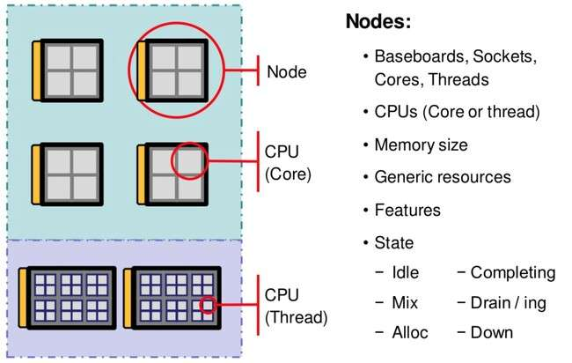
Slurm Vocabulary:
Nodes | Partitions | Jobs
Notes:
A node is simply a single physical or virtual machine in the cluster. Think of it like a computer—but in this case, a really powerful one.
Each node may have:
Multiple CPUs (cores)
A lot of RAM (memory)
Sometimes GPUs
Its own storage
A partition is like a queue or category of nodes. It's a way for the cluster to group similar types of nodes together.
Each partition may be:
Meant for short jobs (e.g., debug)
Optimized for long jobs (e.g., long)
Equipped with GPUs (e.g., gpu)

Slide 7
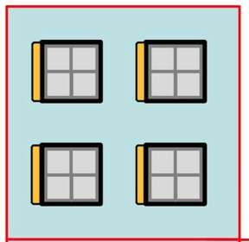
Slurm Vocabulary:
Nodes | Partitions | Jobs
Nodes | Partitions | Jobs
Notes:
A node is simply a single physical or virtual machine in the cluster. Think of it like a computer—but in this case, a really powerful one.
Each node may have:
Multiple CPUs (cores)
A lot of RAM (memory)
Sometimes GPUs
Its own storage
A partition is like a queue or category of nodes. It's a way for the cluster to group similar types of nodes together.
Each partition may be:
Meant for short jobs (e.g., debug)
Optimized for long jobs (e.g., long)
Equipped with GPUs (e.g., gpu)

Slide 8
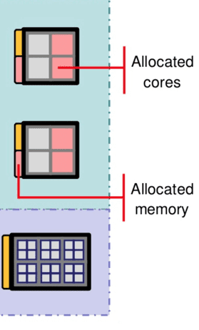
Slurm Vocabulary:
Nodes | Partitions | Jobs
Notes:
A job is your task: it could be a Python script, a simulation, a program, or a model you want to run.
You write your job instructions in a file (called a job script), and Slurm schedules that script to run on one or more nodes.

Slide 9
Getting An Account
CU Boulder, CSU users and affiliates:
Request an account through the RC Account request portal: https://rcamp.rc.colorado.edu/accounts/account-request/create/organization
AMC, RMACC users and affiliates:
Request an account through the ACCESS-CI User Registration Portal: https://identity.access-ci.org/new-user.html

Slide 10
Slurm Job lifecycle : the happy path
Submission
Priority
Wait
Allocation and Execution
Job is added to
the queue
A priority value is assigned to the job.
Job waits in queue until:
Resources are
available
There are no jobs with higher priority in queue
Notes:
A typical Slurm job follows this path:
You write a job script that includes your resource requests and commands.
You submit it using the sbatch command.
The job waits in the queue for resources.
It runs on the assigned node(s).
The output is saved to a file so you can review it later.
If everything goes well, this is the path your job will take from start to finish.

Slide 11

Anatomy of a job script
A batch job consists of a sequence of commands listed in a file with the purpose of being executed by
the OS as a single instruction.
myjob.sh
#!/bin/bash
#SBATCH --nodes=1
#SBATCH --ntasks=1 #SBATCH --mem=1G
#SBATCH --partition=amilan #SBATCH --time=00:10:00
#=SBATCH --job-name=myjob
#SBATCH --output=myjob_%j.out
# script commands
echo "Job started on $(hostname) at $(date)"
sleep 60
echo "Job completed at $(date)"
Notes:
This is where the magic happens: the job script.
A job script is just a shell script (usually .sh) that includes:
Slurm directives – instructions to Slurm on what resources you need.
Shell commands – the code you want to run.
Let’s walk through an example:

Slide 12
Anatomy of a job script
A batch job consists of a sequence of commands listed in a file with the purpose of being executed by
the OS as a single instruction.
myjob.sh
Shebang
Specify the script interpreter (Bash)
Must be the first line!
#!/bin/bash
#SBATCH --nodes=1
#SBATCH --ntasks=1 #SBATCH --mem=1G
#SBATCH --partition=amilan #SBATCH --time=00:10:00
#=SBATCH --job-name=myjob
#SBATCH --output=myjob_%j.out
# script commands
echo "Job started on $(hostname) at $(date)"
sleep 60
echo "Job completed at $(date)"
Notes:
What: Shebang – tells the system to use the Bash shell. Why: Slurm needs to know what shell to use to interpret your commands. Usage: Always the first line. Always use /bin/bash unless told otherwise.

Slide 13
Anatomy of a Job Script
A batch job consists of a sequence of commands listed in a file with the purpose of being executed by
the OS as a single instruction.
myjob.sh
Shebang
Specify the script interpreter (Bash)
Must be the first line!
#!/bin/bash
#SBATCH --nodes=1
#SBATCH --ntasks=1 #SBATCH --mem=1G
#SBATCH --partition=amilan #SBATCH --time=00:10:00
#=SBATCH --job-name=myjob
#SBATCH --output=myjob_%j.out
SLURM DIRECTIVES
Start with “#SBATCH”:
Parsed by Slurm but ignored by Bash.
Must be before actual commands!
# script commands
echo "Job started on $(hostname) at $(date)"
sleep 60
echo "Job completed at $(date)"
Notes:
A directive is a line in your script that starts with #SBATCH. These tell Slurm how to handle your job before it even starts.
#!/bin/bash – Always first! This tells the system to use the Bash shell.
--job-name – Easy identifier in the job queue.
--output – Logs go to a file named myjob_JOBID.out.
--nodes, Specifies how many separate physical nodes (machines) you need.
--ntasks, Requests N parallel tasks (usually 1 per core).
--mem Requests a certain amount of memory (RAM) for your job.
--partition – Specifies which partition (queue) to submit your job to.
(Which lane you're requesting to drive in.)
--time – Max wall-clock time. If the job exceeds it, Slurm kills it.
Always tailor these directives to match the specific requirements of your research task.

Slide 14
Anatomy of a Job Script
A batch job consists of a sequence of commands listed in a file with the purpose of being executed by
the OS as a single instruction.
myjob.sh
Shebang
Specify the script interpreter (Bash)
Must be the first line!
#!/bin/bash
#SBATCH --nodes=1
#SBATCH --ntasks=1 #SBATCH --mem=1G
#SBATCH --partition=amilan #SBATCH --time=00:10:00
#=SBATCH --job-name=myjob
#SBATCH --output=myjob_%j.out
SLURM DIRECTIVES
Start with “#SBATCH”:
Parsed by Slurm but ignored by Bash.
Must be before actual commands!
Script commands
Commands you want to execute on the compute nodes.
# script commands
echo "Job started on $(hostname) at $(date)"
sleep 60
echo "Job completed at $(date)"
Notes:
At the end, you put the commands you’d normally run in the terminal.

Slide 15


Job Submission
Batch vs Interactive
Batch
Job
Interactive
Job
Notes:
There are two ways to run jobs:
1. Batch Jobs Submitted with sbatch. Run without user interaction.
bash
CopyEdit
sbatch myjob.sh
Slurm will return:
bash
CopyEdit
Submitted batch job 123456
Keep this job ID—it’s how you check, cancel, or view info later.
2. Interactive Jobs Use salloc or srun to open a shell on a compute node.
bash
CopyEdit
salloc --partition=debug --time=00:10:00 --ntasks=1 --mem=1G
This is great for testing or using graphical tools or notebooks.
Don’t run compute-heavy tasks on the login node! Always submit them via Slurm.

Slide 16
Job Submission
Batch vs Interactive
sbatch batch_file
Runs the job in the background, without real-time user input.
If successful, returns a job ID.
Best for scheduled and long/big jobs
Batch
Job
Interactive
Job

Slide 17
Job Submission
Batch vs Interactive
sbatch batch_file
salloc options
Runs the job in the background, without real-time user input.
If successful, returns a job ID.
Best for scheduled and long/big jobs
Used to request an interactive job allocation.
Accepts similar options as sbatch
Best for testing and debugging
Batch
Job
Interactive
Job

Slide 18
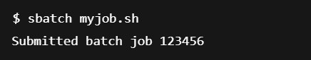
Submit Your First Job
Using sbatch to submit myjob.sh script to Slurm.
sbatch myjob.sh

Slide 19

Submit Your First Job
Using sbatch to submit myjob.sh script to Slurm.
sbatch myjob.sh
How do I remove a job from the queue?

Slide 20
Submit Your First Job
Using sbatch to submit myjob.sh script to Slurm.
sbatch myjob.sh
How do I remove a job from the queue?
scancel job_id
Cancel the running or pending job from the queue using the corresponding job_id.

Slide 21
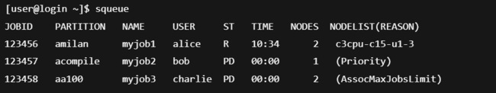
Check Job Queue
squeue options
This command is used to pull up information about the jobs currently in the Slurm queue.
By default, the command will print out information for all jobs queued or running.
To view jobs queued by a specific user use the -u flag
squeue -u user_name
Notes:
Lists jobs based on jobid and not priority

Slide 22
Check Job Status
squeue
By default, the command will print out the job ID, partition, username, job status, number of nodes, and name of nodes for all jobs queued or running.
Status
R = Running
PD = Pending
CA = Cancelled
CD = Completed

Slide 23
Interpreting Reason Codes
Priority | Other jobs in queue have higher priority.
Resources | Insufficient resources available on the cluster.
Dependency | This job is waiting for a dependent job to complete and will run afterward.
AssociationMaxJobsLimit | Maximum number of jobs for your job’s association have been met.
QOSGrpCpuLimit | All CPUs assigned to your job’s specified QoS are in use.

Slide 24
When Things Go Wrong With Slurm Jobs
Allocation and Execution
Submission
Priority
Wait

Slide 25
After a Job Fails, Ask Yourself...
What do I know about the failure?
Did I get any error messages?
Was my job request realistic?

Slide 26
After a Job Fails, Ask Yourself...
Did the job finish or crash midway?
Did it run, or just queued and failed before starting?
What do I know about the failure?
Did I get any error messages?
Was my job request realistic?

Slide 27
View Historical Job Info
sacct options
Check back on usage statistics of previous jobs.
By default, only checks all jobs from the start of the current day
sacct --format=var_1,var_2, ... ,var_N
Variable | Description
account | Account the job ran under.
elapsed | Jobs elapsed time formatted as DD-HH:MM:SS.
exitcode | The exit code returned by the job script
jobid | The id of the Job.
jobname | The name of the Job.
ntasks | Number of tasks in a job.
reqmem | Required amount of memory for a job.
sacct --start=MM/DD/YYYY
sacct -j job_id
Notes:
use “sacct --helpformat" for a list of available fields

Slide 28
After a Job Fails, Ask Yourself...
What do I know about the failure?
Were there any module errors?
Was a file or command missing?
Any permission errors?
Did I get any error messages?
Was my job request realistic?

Slide 29
Check The Logs
less slurm-<job_id>.out less slurm-<job_id>.err
Look for common issues like:
❌ Module errors: command not found, module load failed
❌ Missing files: No such file or directory
❌ Permissions: Permission denied

Slide 30
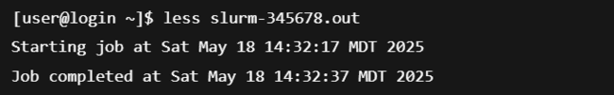
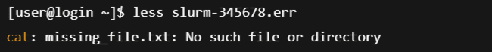
Check The Logs
less slurm-<job_id>.out less slurm-<job_id>.err
Look for common issues like:
❌ Module errors: command not found, module load failed
❌ Missing files: No such file or directory
❌ Permissions: Permission denied

Slide 31
Check The Logs
less slurm-<job_id>.out less slurm-<job_id>.err
Look for common issues like:
❌ Module errors: command not found, module load failed
❌ Missing files: No such file or directory
❌ Permissions: Permission denied
sacct -j job_id -B
The -B option will print the batch script of job if the job used one. If the job didn't have a script 'NONE' is output.
Notes:
Incase you need to see what script was submitted for a particular jobid sacct -j <job_id> -B --format=JobID,State,ExitCode What does the -B flag do? -- print the batch script of the job

Slide 32
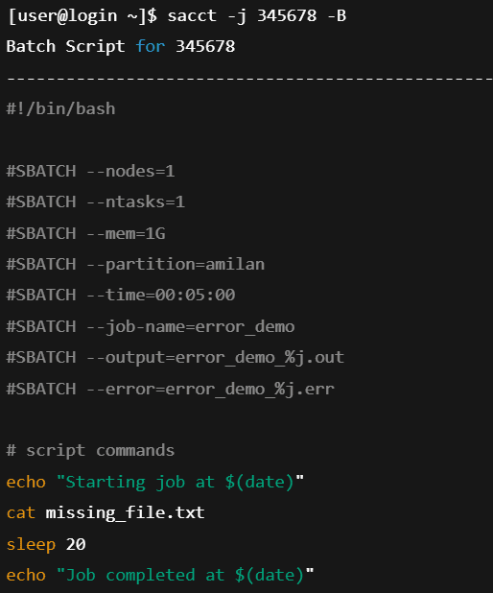
Check The Logs
less slurm-<job_id>.out less slurm-<job_id>.err
Look for common issues like:
❌ Module errors: command not found, module load failed
❌ Missing files: No such file or directory
❌ Permissions: Permission denied
sacct -j job_id -B
The -B option will print the batch script of job if the job used one. If the job didn't have a script 'NONE' is output.

Slide 33
After a Job Fails, Ask Yourself...
What do I know about the failure?
Did I get any error messages?
Did I request too much memory, time, or CPUs?
Was the partition selected available and ready for my job?
Did my job use the resources I requested efficiently?
Was my job request realistic?

Slide 34
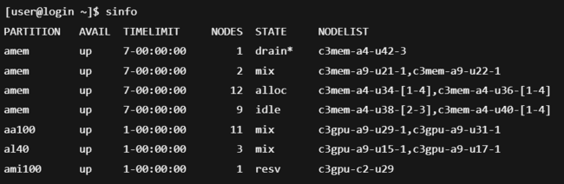
Cluster State and Partition Details
sinfo options
A quick way to check the cluster
Notes:
If your job is pending for a long time, it might be waiting for resources that aren’t currently free — or don’t exist in the partition you chose.

Slide 35
Cluster State and Partition Details
sinfo options
A quick way to check the cluster
idle | Node is up and fully available for job scheduling
alloc | Node is fully allocated to one or more running jobs
mix | Node is partially allocated – some CPUs in use, others still available
drain* | Node is in a failed state and draining.
resv | Node is reserved (e.g., for specific users, groups, or jobs)
down | Node is offline or unreachable

Slide 36
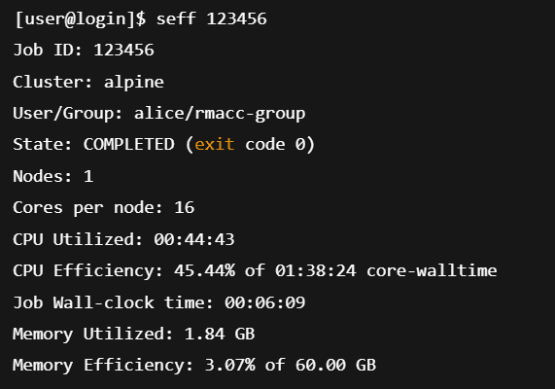
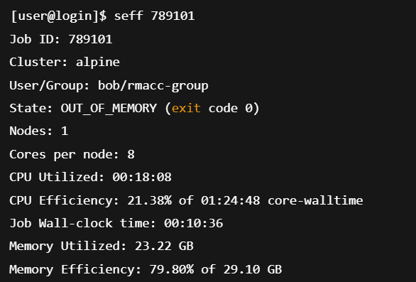
Job Efficiency Summary
seff job_id
This command is used to display the information about the job's CPU and memory utilization.
Gives users feedback on how well their job used the requested resources.
Efficiency statistics are only available for jobs that have completed
Notes:
This shows how efficiently you used memory and CPU:
Low CPU usage? Maybe your program is I/O-bound or you requested too many tasks.
Low memory usage? Maybe you requested more than you needed.
Optimizing your requests helps everyone by reducing queue times.
Common exit codes 0 – Success!
1 – Something went wrong in your script.
126/127 – Command not executable / not found.
137 – Killed (usually ran out of memory or time).

Slide 37
Hands-on Tutorial

Slide 38
Logging Into Research Computing
Login to CURC via your terminal (CU Boulder): $ ssh mokh8410@login.rc.colorado.edu
…or login to CURC via your browser (all users): https://ondemand-rmacc.rc.colorado.edu
(once logged in, navigate to Clusters -> Alpine shell)

Slide 39
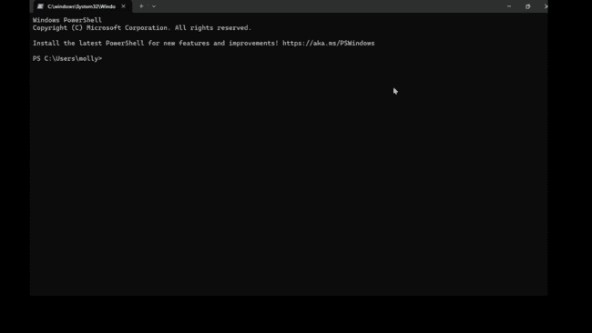
Exercise
In this section, we’ll walk through a live demo of how to write, submit, troubleshoot, and evaluate a Slurm job, step by step.
Want to try it later?
Download this full hands-on example from our GitHub: github.com/ResearchComputing/rmacc_2025/

Slide 40

More Documentation!
Official Slurm Docs!
https://slurm.schedmd.com/documentation.html
CURC Slurm Guide
https://curc.readthedocs.io/en/latest/running-jobs/slurm-commands.html

Slide 41


Questions
Comments

